Slide 1
ITAP
Many BTs have several strategies for formative assessment but the emphasis now is on sharpening their understanding of how and when to use these.
The focus for this ITAP is on where in the lesson assessment is taking place and for what purpose.
There is also a focus on how assessment is taking place by looking in detail at the language used when designing assessment opportunities such as MCQs.

Slide 2
Introduction
What is formative assessment?
Scenarios to consider – are these formative assessment?
Signposting to reading for possible use in second assignment.

Slide 3
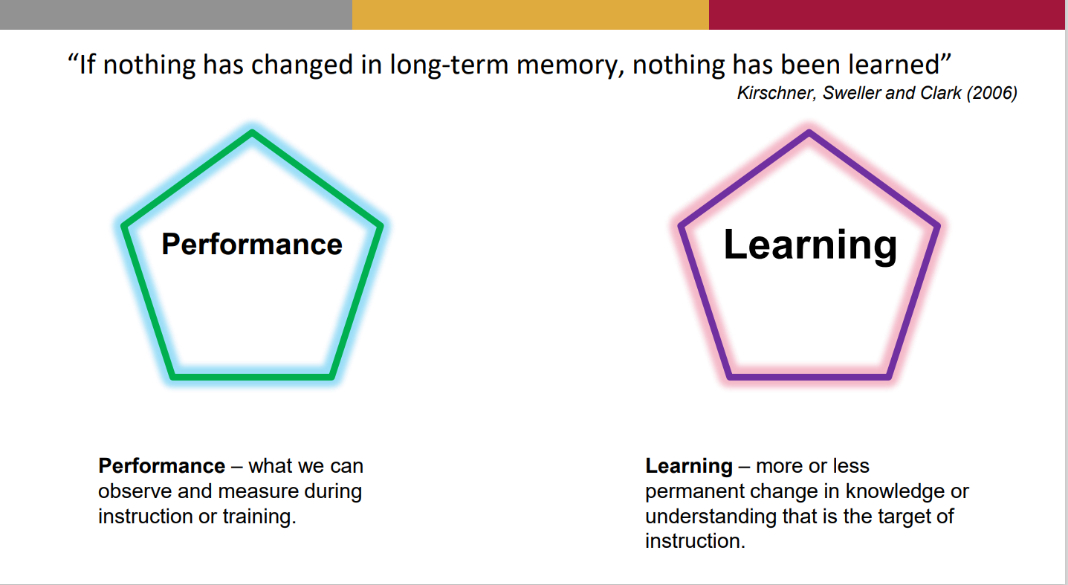

Slide 4
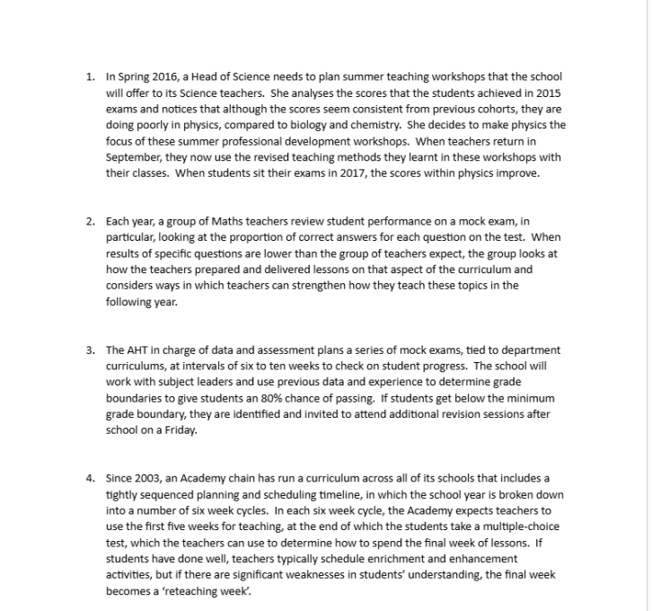

Slide 5
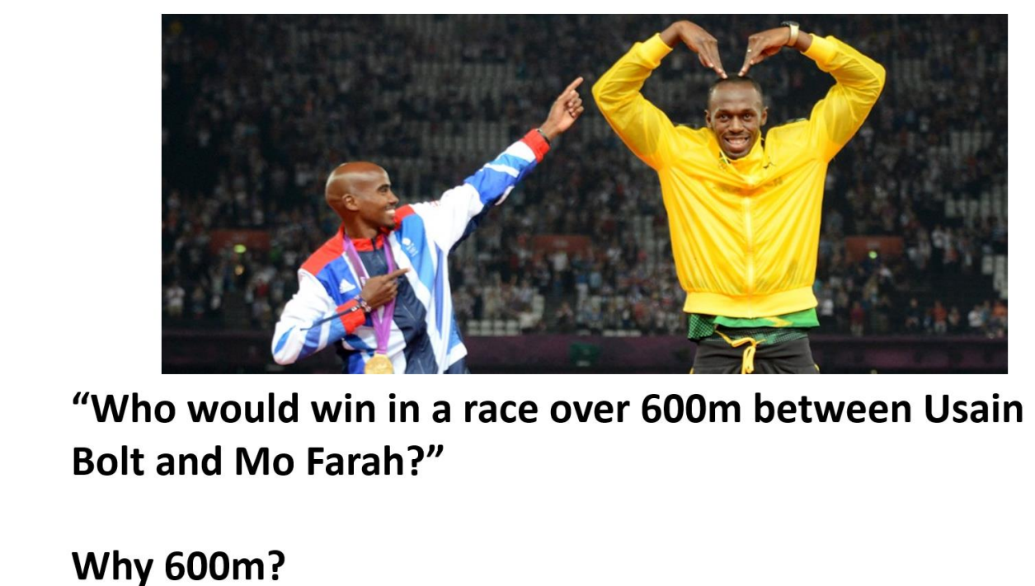
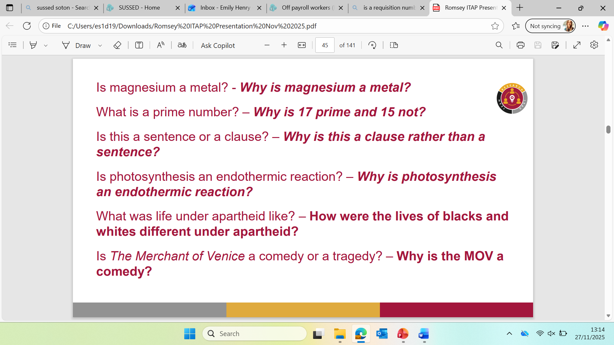
How to find out what pupils already know?
Framing questions that test understanding
Starting with ‘why’ to explore answers

Slide 6
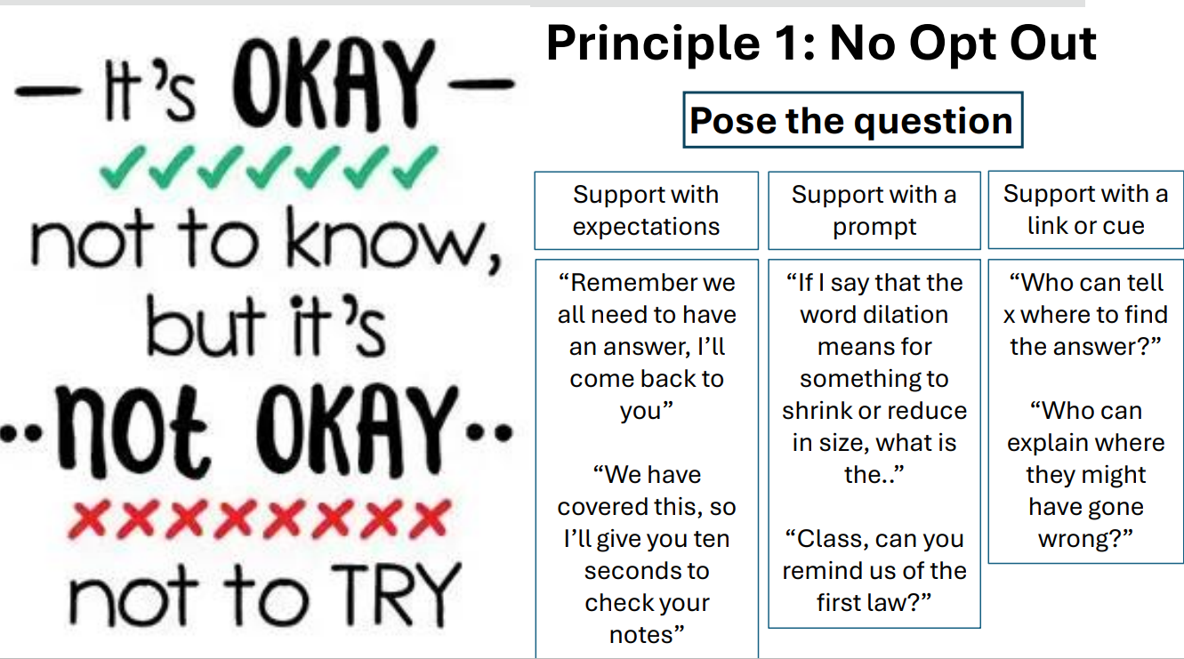
During the Lesson
How can you encourage participation?
How can you modify language to encourage full participation when questioning?

Slide 7
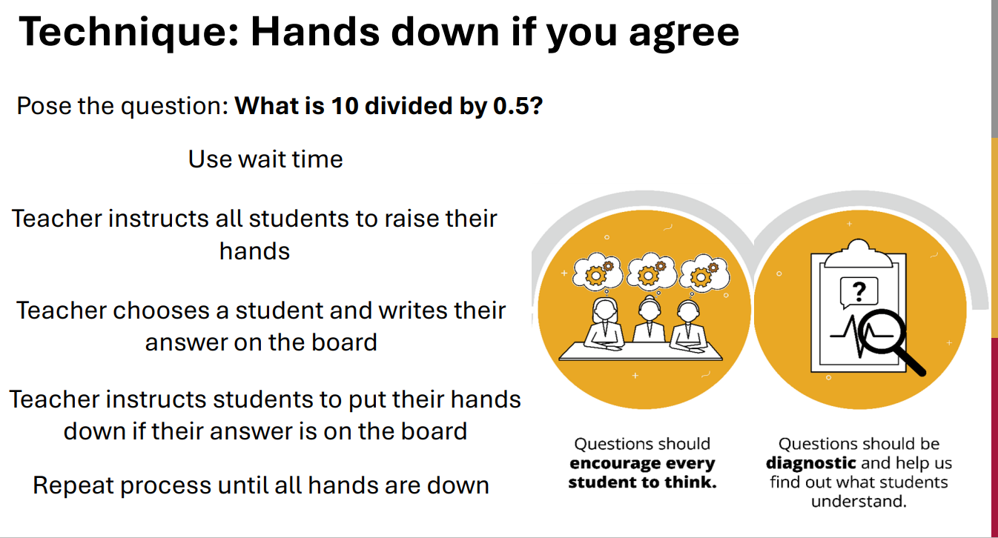

Slide 8
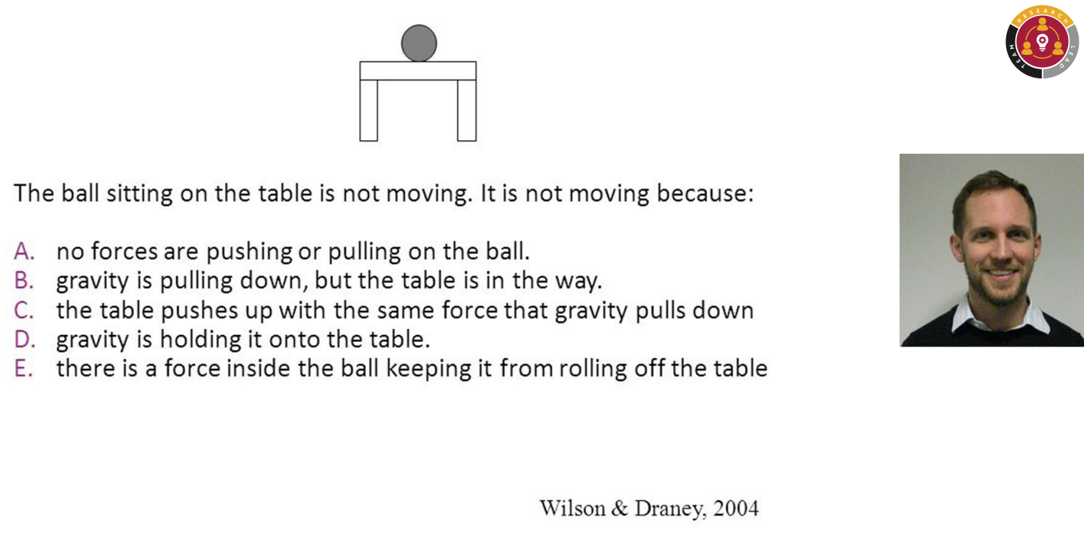
When to move on?
Hinge questions- designing effective questions.

Slide 9
What do you do with formative assessment?
Exit tickets
Mini whiteboards
Hands up
What do you do with the information?
How do you know when to move on or recap?

Slide 10
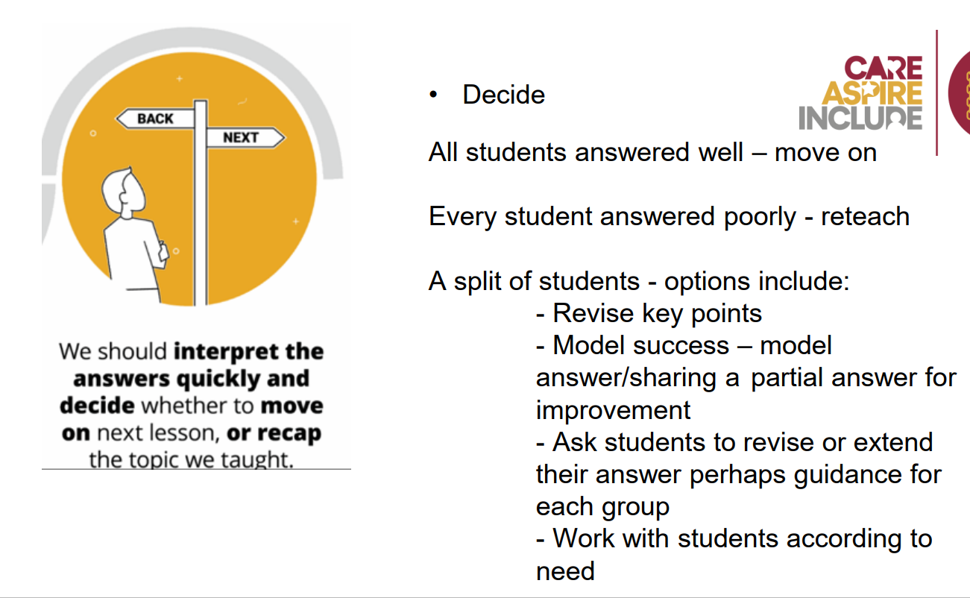

Slide 11
Follow up in Schools
Beginning Teachers worked on lesson plans for a lesson they will be teaching in their main placement. Senior staff read and discussed these with BTs to test their understanding of why they had designed the assessment opportunities they had. They have taught a key part of that lesson to their peers during subject follow-up and now need to teach the full lesson in schools.

Slide 12
What should feedback look like?
Mentors should focus on which methods of assessment were used at key points in the lesson and explore during feedback why these were chosen.
Were these always necessary?
What information was gained from each activity? (whole-class understanding/a snapshot of a particular group etc)
There should also be discussion around the language used in each task e.g. Did multiple choice questions lead pupils to a particular answer? Did it allow them to guess? Etc.

